Slide 1
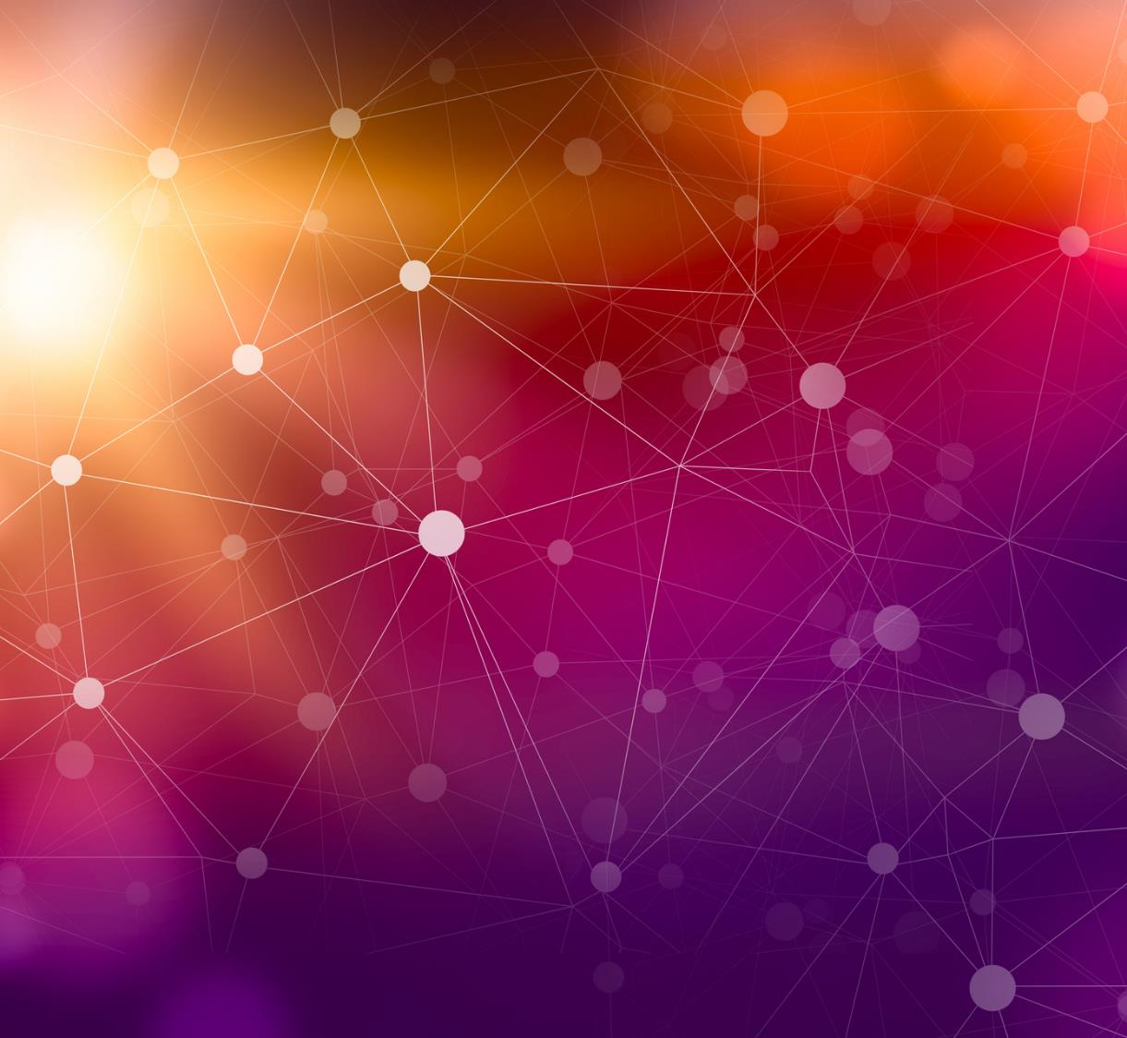

Synopsis on Chatgpt
Atul Anand

Slide 2
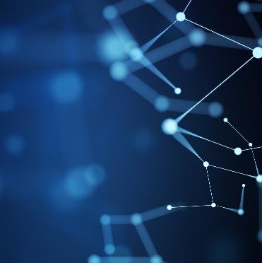
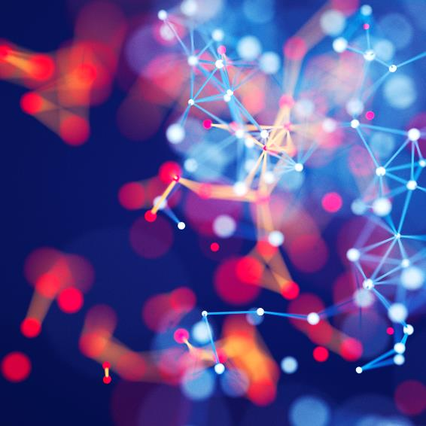
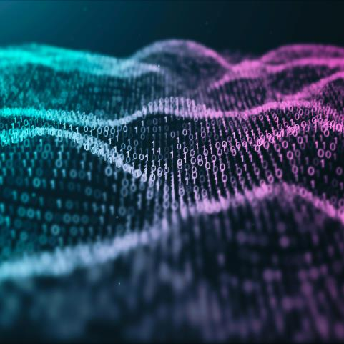
Agenda
Introduction
Working and Algorithms
Infrastructure Setup
Meet the Great Minds
Future Plan
How people can make business from Chatgpt
Difference between Chatgpt and Chatbots
Advantages and Disruption in Industry
Disadvantages

Slide 3
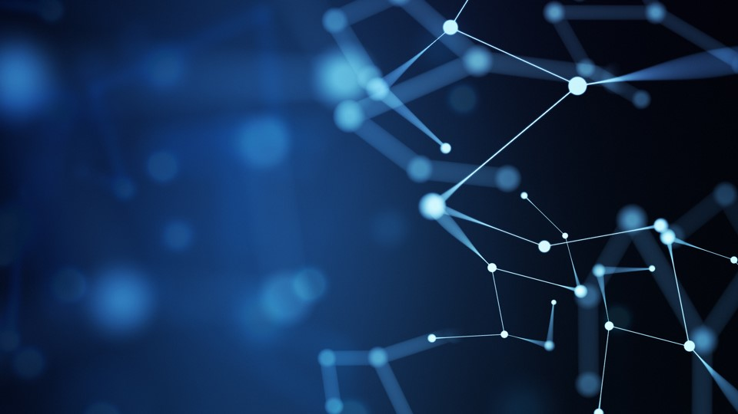
Introduction:
Chatgpt is large-scale language model developed by OpenAI and was launched on November 30,2022. It has been funded by Microsoft around $3 billion from 2019-2022.
It is trained on a massive dataset till 2021 of internet text, allowing it to generate human-like responses to a wide range of prompts.
ChatGPT can be fine-tuned for a variety of language tasks, such as conversation, summarization, and question answering, and it is based on the GPT (Generative Pre-trained Transformer) architecture and can generate text that is often indistinguishable from text written by humans.

Slide 4
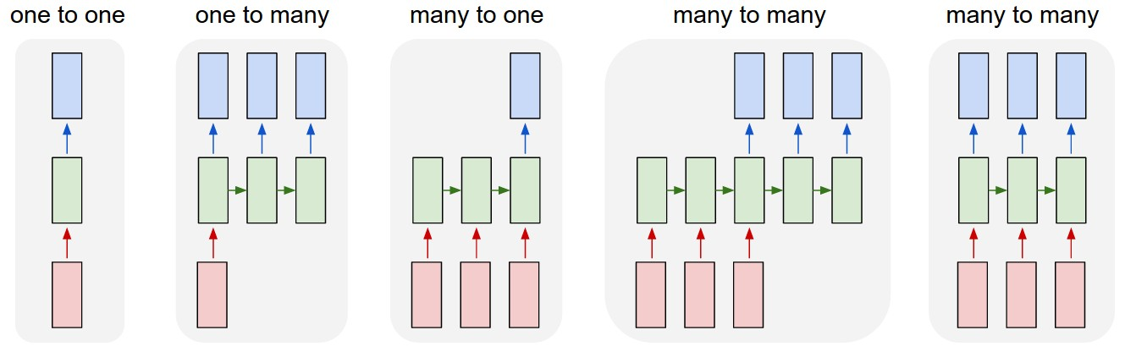
Working and Algorithms
Chatgpt uses a deep neural network architecture known as a transformer, which is based on the idea of self-attention.
The core mathematical intuition behind the transformer architecture is the attention mechanism. Attention allows the model to focus on specific parts of the input when making predictions, rather than using the entire input equally.

Slide 5
Working and Algorithms
The attention mechanism is implemented using dot-product attention, which calculates the dot product of the query, key, and value for each position in the input. These dot products are then used to create a weighting for each position, which is used to compute a weighted sum of the values.
The transformer architecture also uses multi-head attention which allows the model to attend to different parts of the input in parallel. Each head of attention allows the model to focus on different aspects of the input.
Another important component of the transformer architecture is the use of a feed-forward neural network, which is used to generate the output. The feed-forward network is responsible for learning the complex relationships between the input and output, allowing the model to generate predictions that are based on the input.
Additionally, the model is pre-trained on a large amount of text data, so it can generate text that is coherent and contextually appropriate. The pre-training helps the model to learn general information about the structure of language, such as grammar and vocabulary.

Slide 6
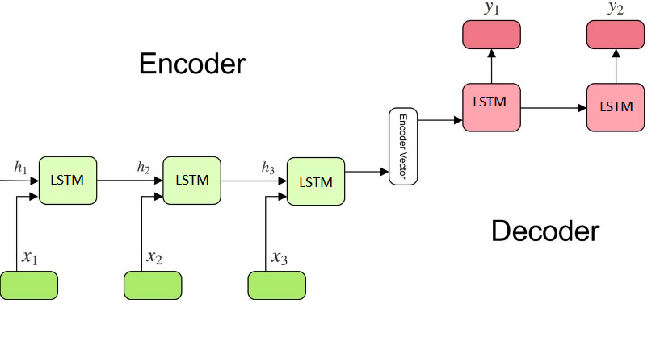
Working and Algorithms
SOTA : SOTA stands for "state-of-the-art." In the field of machine learning and artificial intelligence, SOTA algorithms refer to the current best-performing algorithms or models in a particular task or domain. These algorithms have been found to have the highest accuracy, lowest error rate, or other relevant metrics compared to other methods available. SOTA algorithms are often used as a benchmark for new research. Examples of SOTA algorithms include BERT for natural language understanding, GPT-3 for language generation, and AlphaGo for game-playing.
Encoder-Decoder Architecture: https://jalammar.github.io/visualizing-neural-machine-translation-mechanics-of-seq2seq-models-with-attention/

Slide 7
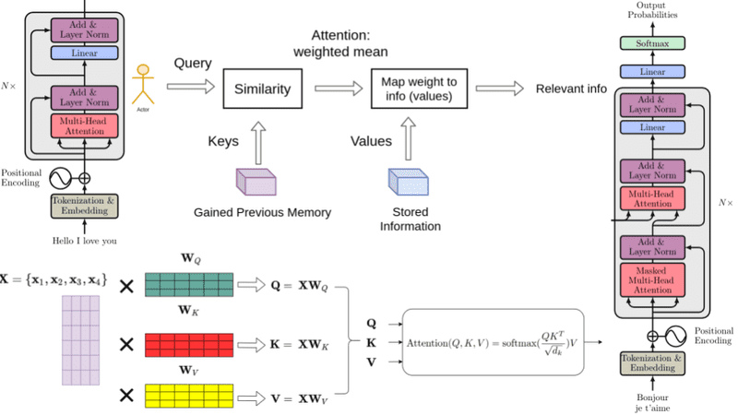
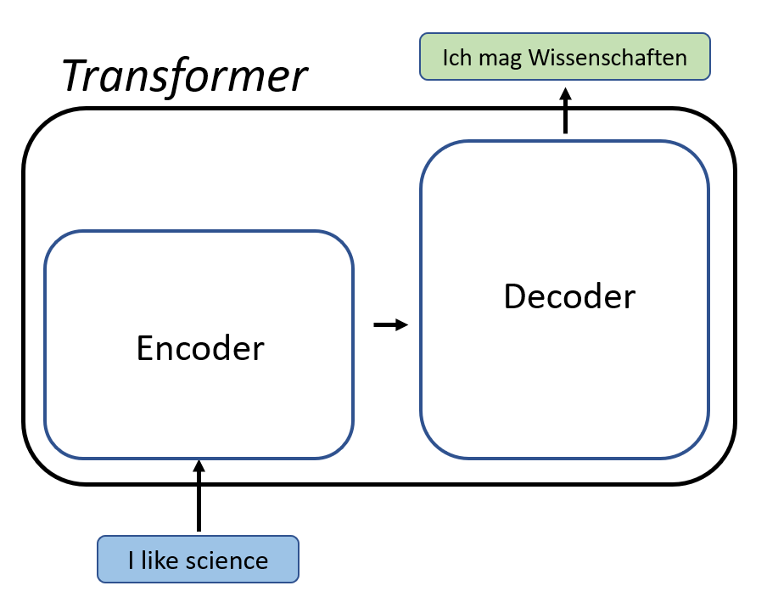
Working and Algorithms
Self-Attention Architecture: https://jalammar.github.io/illustrated-transformer/

Slide 8
Infrastructure Setup:
Hardware: ChatGPT and other large-scale language models require powerful hardware, such as high-end GPUs, to perform the complex calculations required for training and inference.
Storage: Large-scale language models like ChatGPT require a significant amount of storage to store the model parameters and training data. This can be in the form of local storage or cloud storage.
Memory: The training and inference of large-scale language models require a large amount of memory to hold the model parameters and intermediate calculations.
Networking: Large-scale language models like ChatGPT can require a lot of data transfer between the storage and compute resources, so a high-speed network is essential.
Cloud Services : Cloud services like AWS, Azure, and GCP can be used to run ChatGPT and other large-scale language models. These services provide powerful hardware, storage, and networking resources that can be scaled up as needed.
Distributed computing: For large-scale training and inference, distributed computing frameworks like TensorFlow and PyTorch can be used to spread the workload across multiple GPUs and machines, which can speed up the process.
Software: The software required to run ChatGPT includes deep learning frameworks like TensorFlow or PyTorch and programming languages such as Python.
DevOps: To run the model at scale, it's important to have an infrastructure that is able to handle the deployment, scaling and monitoring of the models, for this, DevOps practices and tools are essential.

Slide 9

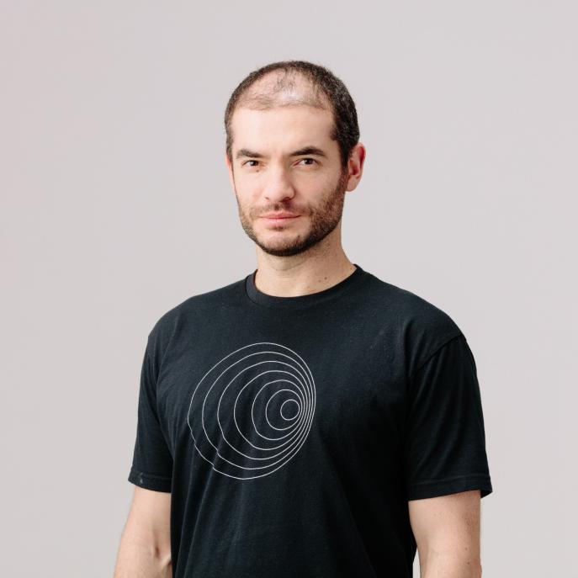

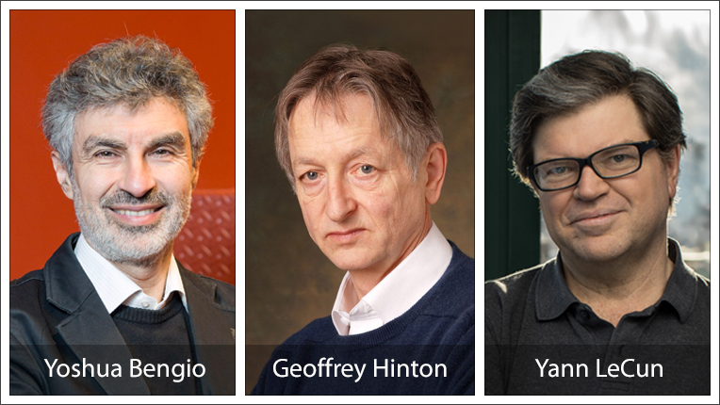

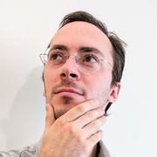
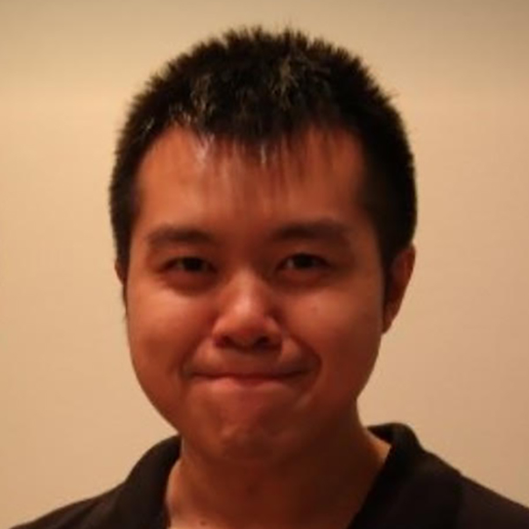
Meet The Great Minds:
Great Minds (OpenAI Team): David Ha
Greatest Minds:
Alec Radford
Ilya Sutskever
Dario Amodei
Yann LeCun: Chief AI Scientist @Meta
Yoshua Bengio: Professor @University of Montreal
Geoffrey Hinton: Researcher @Google Brain
Jack W. Rae
Chris Hesse
David Ha
Many More………

Slide 10
Future Plan:
Education: ChatGPT and other large-scale language models can be used to generate educational content, like summaries, question-answers, and even essays.
Healthcare: ChatGPT and other large-scale language models can be fine-tuned for medical domain and used in various applications like medical document summarization, medical coding, and even virtual medical assistant.
Robotics and IoT: ChatGPT and other large-scale language models could be used to create more natural-sounding interfaces for robots and other IoT devices, making it easier for people to interact with them.
Language-based creativity: With GPT-3, OpenAI introduced the language model's creative capabilities, like writing a story, composing poetry, and even coding. This can be further improved and used in various creative fields.
Language understanding: ChatGPT and other models can be fine-tuned to understand the meaning of text and answer questions. This will be used in various NLP tasks like Question answering, text classification, and named entity recognition.
Dialogue Systems: ChatGPT and other large-scale language models could be used to create more natural-sounding chatbots and dialogue systems for customer service, information provision, and other applications.
Personal Assistants: ChatGPT and other language models could be used to create personal assistants that can understand natural language commands and respond appropriately.

Slide 11
How people can make business from Chatgpt
Chatbot development: ChatGPT can be fine-tuned to create chatbots for customer service, e-commerce, and other applications. These chatbots can handle a wide range of customer inquiries and provide accurate and natural-sounding responses.
Content generation: ChatGPT can be used to generate high-quality content for websites, social media, and other platforms. This can save businesses time and resources by automating content creation.
Language Translation: ChatGPT can be fine-tuned for language translation, which can be useful for businesses that operate internationally and need to communicate with customers or partners in multiple languages.
Language-based services: ChatGPT can also be used for various language-based services such as text summarization, text completion, question answering and many more.
Research and development: Companies can also use ChatGPT for research and development of new AI-based products and services.
Marketing campaigns: ChatGPT can be used to generate creative and engaging marketing campaigns, such as social media posts, email newsletters, and video scripts.
Consulting: Companies can offer consulting services to other businesses on how to implement and use ChatGPT and other language models in their operations.

Slide 12
Difference between Chatgpt and Chatbots
ChatGPT | Chatbots
Large-scale language model | Computer programs that simulate human conversation
Trained on a massive dataset of internet text | Can use various language models or rule-based systems for generating responses
Generates text that is often indistinguishable from text written by humans | Can be used for a wide range of tasks such as customer service, providing information, and making recommendations
Can be fine-tuned for specific tasks like language summarization, language translation, and question answering | Specific application of language model that is designed to simulate human conversation
AI Engine | Specific Application of AI Engine
In summary, ChatGPT is a large-scale language model that can be used to generate human-like text, while chatbots are computer programs that are designed to simulate human conversation. ChatGPT can be used
to train chatbots to generate more natural and engaging text, but it is not a chatbot itself.

Slide 13
Advantages and Disruption in Industry
Advantages:
High level of accuracy: ChatGPT is trained on a massive dataset of internet text, and as a result, it can generate text that is often indistinguishable from text written by humans.
Human-like language generation: ChatGPT can generate text that is natural and coherent, making it ideal for applications such as chatbot development and content generation.
Handling rare or unseen words: ChatGPT has been trained on a diverse set of internet text, so it can handle rare or unseen words and phrases.
Low-cost: ChatGPT, as a pre-trained model, eliminates the need for businesses to train their own models, which can be costly and time-consuming.
Multilingual capability: ChatGPT can be fine-tuned for multiple languages, which makes it ideal for businesses that operate in multiple countries or that want to reach a global audience.
Versatility: ChatGPT can be used for a wide range of applications such as language translation, language summarization, and language generation
Scalability: ChatGPT can process large amounts of text, making it well suited for tasks that require processing large volumes of data.

Slide 14
Disruption in Industry
Improving the accuracy and fluency of language generation: ChatGPT's ability to generate human-like text has made it possible for businesses to use chatbots and virtual assistants that are more natural and engaging for users.
Reducing the cost of language processing: The pre-training of ChatGPT eliminates the need for businesses to train their own models, which can be costly and time-consuming.
Enabling new applications: ChatGPT's flexibility allows businesses to use it for a wide range of language tasks, such as conversation, summarization, and question answering, which has enabled new applications in fields such as customer service, content generation, and marketing.
Transforming the field of NLP: The high level of accuracy and fluency achieved by ChatGPT and other language models has set new benchmarks for the field and has led to an increase in research and development in the area.
Changing the way we interact with machines: ChatGPT has enabled more natural and human-like interactions with machines, which can improve the user experience and make it easier for people to access information and services.
Multilingual Capability: ChatGPT can be fine-tuned for multiple languages which is a major step towards making NLP technology more accessible to people all over the world.

Slide 15
Disadvantages:
Dependence on AI: If people depend too much on AI-based systems like ChatGPT, they may become less able to think critically, solve problems, and make decisions independently.
Job Loss: ChatGPT and other similar AI models can automate certain tasks that are currently performed by humans, which could result in job loss.
Privacy concerns: ChatGPT is a powerful tool for natural language processing, and there may be concerns about how it is used to process and analyze large amounts of personal data.
Bias: The training data used to create ChatGPT may contain biases, which can be reflected in the model's responses.
Misinformation: ChatGPT is trained on a large dataset of text from the internet, so it may produce inaccurate or misleading information if it is not properly fact-checked.

Slide 16
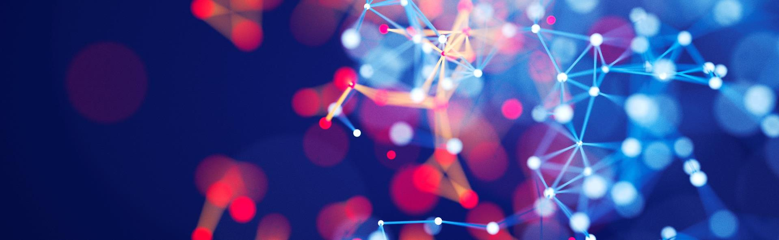
Summary
ChatGPT is a large-scale language model developed by OpenAI that uses a transformer architecture and deep learning to generate human-like text. It has the ability to understand and generate natural language text, making it useful for a variety of applications such as chatbots, language translation, and text generation. ChatGPT has the potential to be used in a wide range of applications and has been used in a number of creative and professional fields.

Slide 17
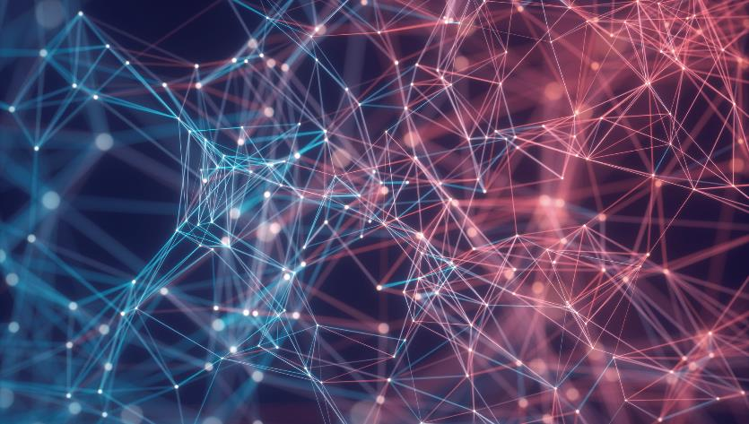
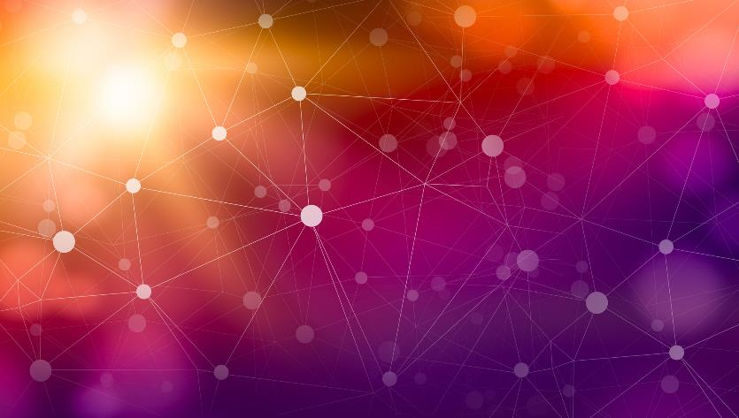
Thank You
Atul Anand

